Slide 1

TELENGANA WEATHER ANALYSIS
(Using Power BI)
Presented by : Sourav Kumar Sahu
D. Manikanta
Batch No : 403
INNOMATICS RESEARCH LABS,
DILSUKHNAGAR, HYDERABAD

Slide 2
TABLE OF CONTENT
Problem Statements
Problem Objective
Tools and Approach
Table Information
Model View
Data Visualizations
Dashboard Overview
Conclusion

Slide 3
PROBLEM STATEMENT
Data Fragmentation: Weather data exists in raw, daily time-series formats, making long-term trend analysis difficult.
Lack of Insight: No centralized, visual tool exists to easily compare weather patterns across different Districts/Mandals.
Decision Support: Critical stakeholders (Agriculture, Disaster Management) lack immediate access to seasonal trends and extreme weather alerts.

Slide 4
OBJECTIVE
Centralization: Build a single, interactive dashboard to consolidate and visualize key metrics (Rainfall, Temperature, Wind Speed, Humidity).
Trend Analysis: Identify significant seasonal patterns, annual trends, and Year-over-Year (YoY) changes for each weather parameter.
Geographical Comparison: Enable granular comparison of weather metrics between specific Districts and Mandals.

Slide 5
TOOLS AND APPROACH
Tool : This entire project was built using Microsoft Power BI.
Process:
Data Connection: Loaded the raw Telengana weather data based on 2021,2022,2023 and 2024.
Data Modeling: Cleaned the data and created DAX measures to calculate KPIs like Total Days of Data, Average Max Temp, Average Wind Speed and Total Rainfall.
Visualization: Designed this interactive dashboard with simple filters for Date, Seasons and Month.

Slide 6
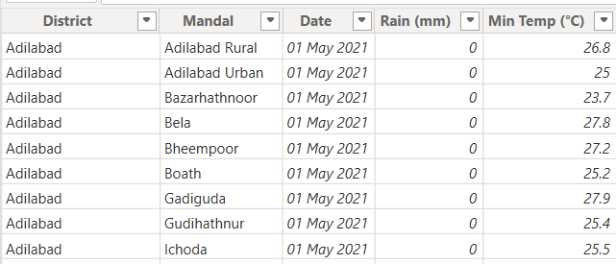
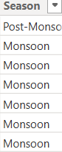
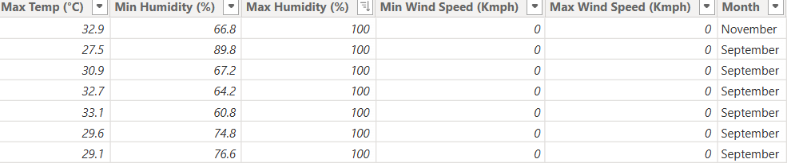
TABLE INFORMATION
Tables used : Four Tables (Weather Data – 2021, 2022, 2023 and 2024)
Columns Name and their data type:
District (text)
Mandal (text)
Date (date)
Rain in mm (decimal)
Min Temp (decimal)
Max Temp (decimal)
Max Humidity (decimal)
Min Humidity(decimal)
Min Wind Speed (decimal)
Max Wind Speed (decimal)
Month (text)
Season (text)

Slide 7
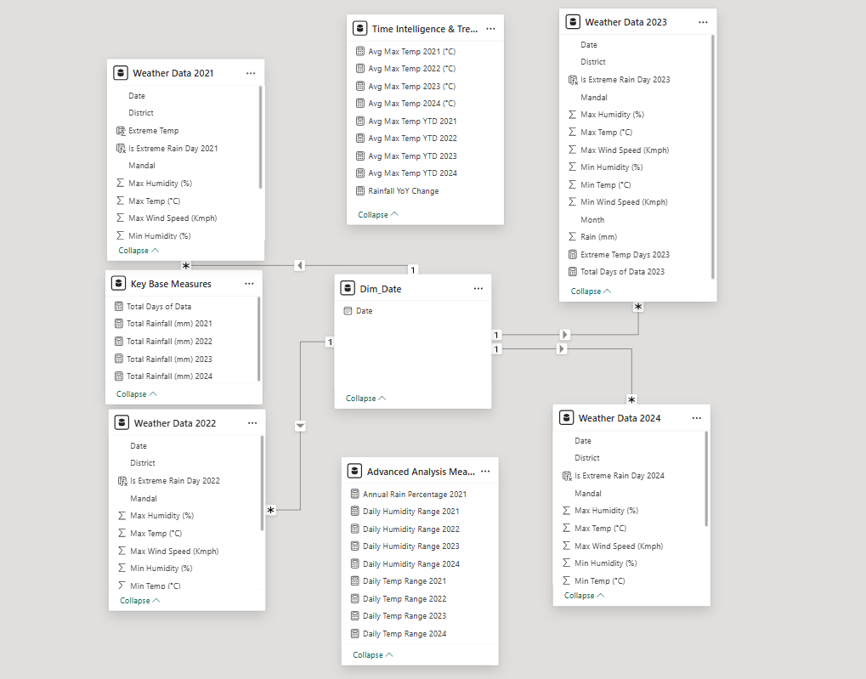
MODEL VIEW

Slide 8
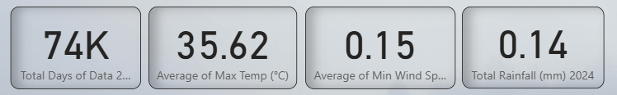
DATA VISUALIZATION
This dashboard gives us an instant summary of weather performance:
Total Days of Data : We managed 1,73,000 days of data for year 2021.
Avg. of Max Temp: We measured 33°C as average of maximum temperature.
Avg. Min Wind Speed: Average of 0.10 kmph wind speed.
Total Rainfall: The total rainfall occurred is around 6,88,000 mm for year 2021.

Slide 9
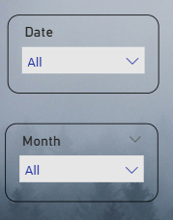
The images provided show two Power BI Slicers, which are crucial interactive components that allow users to filter the entire dashboard instantly.
These two slicers provide essential segmentation controls for the user.
Date Slicer : Filters the entire dataset based on the date of the weather record.
Month Slicer : Filters the entire dataset based on the month and the weather condition for that particular month.

Slide 10
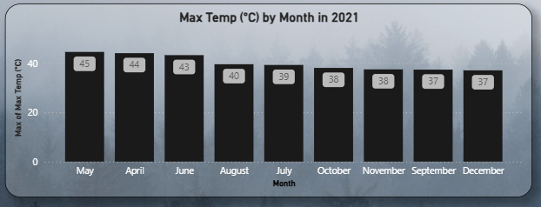
What is the maximum temperature by Month in year 2021 ?
Clear Peak Heat Season : The highest temperatures occur in April and May, both peaking at approximately 45°C .This identifies the pre-monsoon period as the hottest time of year for the region.
Temperature Drop in Monsoon: There is a noticeable temperature drop of 4°C to 5°C when moving from the peak heat months (May) into the early monsoon months (July, August, October).
Coolest Period and Post-Monsoon Warmth: December is the coolest month on average, with the maximum temperature dropping to around 37°

Slide 11
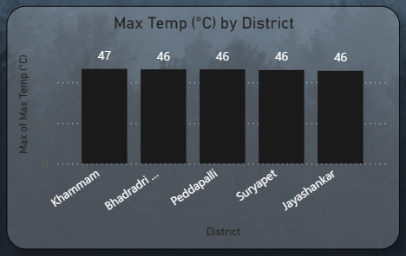
What is the 5 highest temperature by District in year 2023 ?
All five listed districts have recorded an absolute maximum temperature of 46°C or higher at some point in the dataset.
Khammam District recorded the single highest temperature in the dataset, peaking at 47°C.
While Khammam is the highest, the difference between the absolute record high and the other four districts (Bhadradri Kothagudem, Peddapalli, Suryapet, and Jayashankar) is only 1°C.

Slide 12
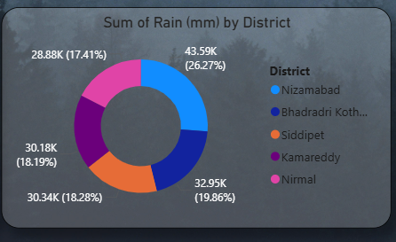
Highest Rainfall Occurred in Top 5 Districts.
1. Nizamabad is the Rain Leader
Nizamabad District received the highest total rainfall, accounting for over a quarter (26.27%) of the precipitation among these five regions.
2. Equal Rainfall Among the Other Districts
Four of the five districts (Bhadradri Kothagudem, Siddipet, Kamareddy, and Nirmal) show a remarkably similar rainfall sum, each contributing between 17% and 20% of the total rainfall.

Slide 13
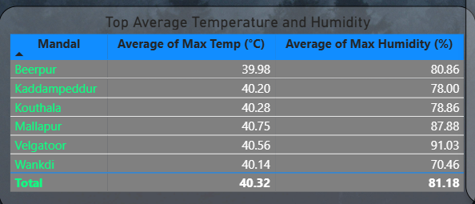
Top 6 Mandal having Highest average of maximum temperature and humidity.
All listed Mandals (6 of them) recorded an average maximum temperature of 40°C or higher (e.g., Kouthala at 40.28 °C )
Despite having similar high temperatures, Humidity levels show extreme variation.
The Mandal of Mallapur (40.75 °C ) and Velgatoor (40.56 °C ) are the two most critical areas, as they combine both the highest average temperatures and significantly high humidity (87.88% and 91.03% respectively)

Slide 14
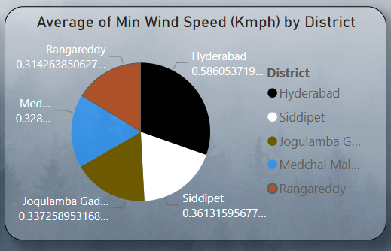
Top 5 Average of Min Wind Speed (kmph) by District.
Hyderabad has the highest average minimum wind speed at approximately 0.59 kmph. While still very low, this indicates that Hyderabad is the least likely among these five districts to experience completely still (calm) air, suggesting it is consistently the windiest, even at its minimum.
he other four districts (Siddipet, Jogulamba Gadwal, Medchal Malkajgiri, and Rangareddy) show highly consistent average minimum wind speeds, all falling in a narrow range between approximately 0.31 and 0.36 kmph.

Slide 15
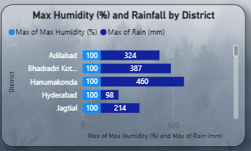
Maximum Humidity and Rainfall occurred by District
All listed districts have a maximum humidity of 100%, showing high moisture in the air.
Hanumakonda district received the highest recorded rainfall (460 mm), while Hyderabad had the lowest (98 mm).
Most districts with high humidity also received significant rainfall, except Hyderabad, which had low rainfall despite high humidity.

Slide 16
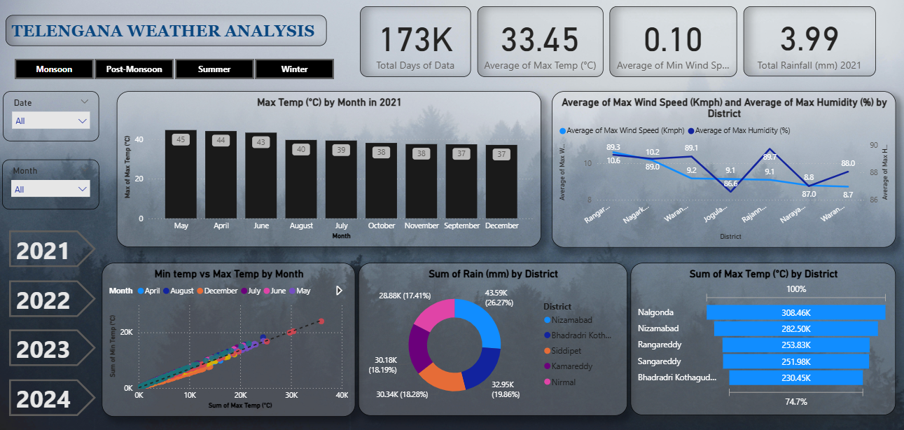
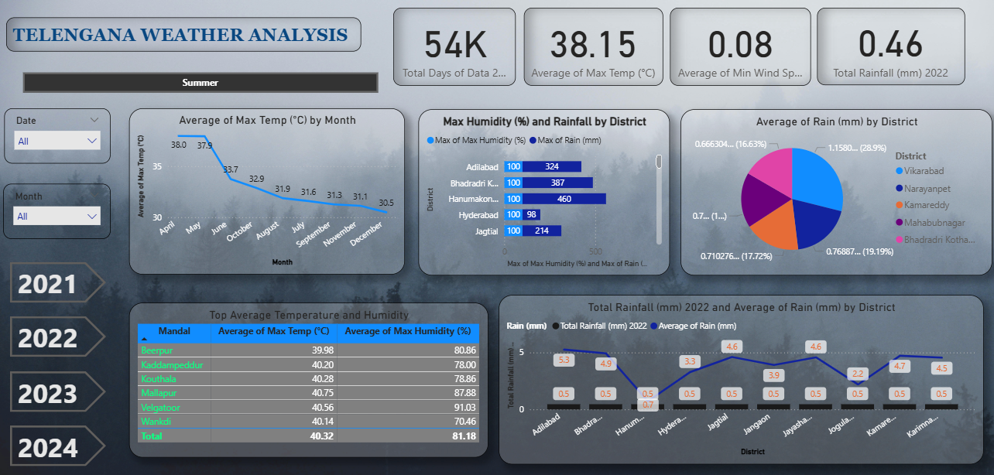
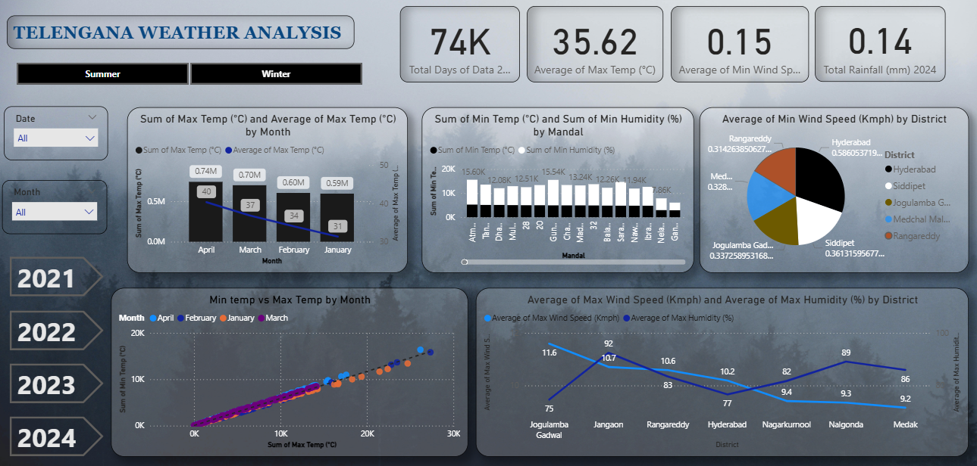
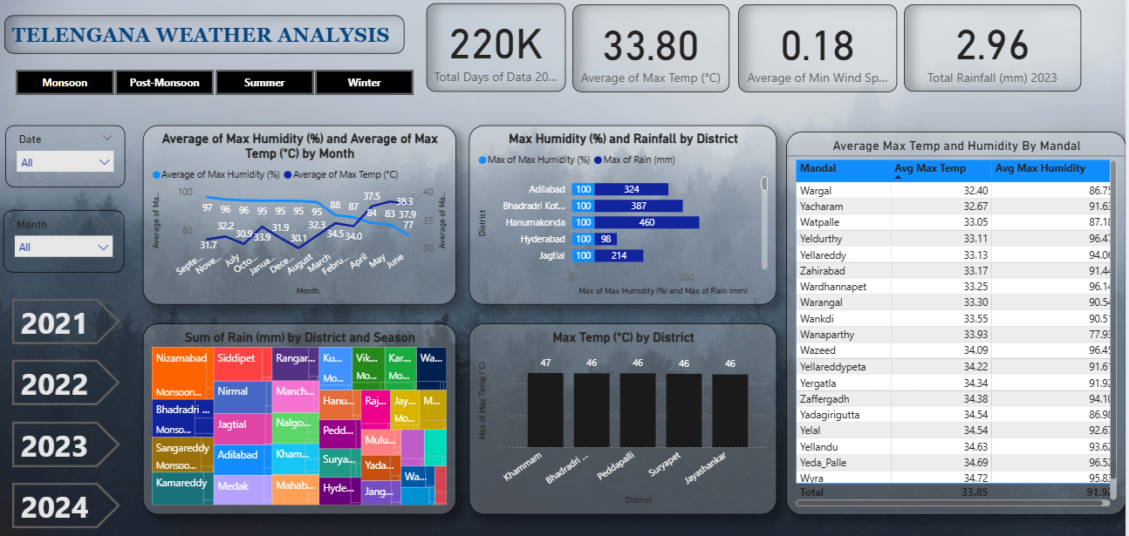
DASHBOARD OVERVIEW

Slide 17
CONCLUSION
The Telangana Weather Analysis project successfully established a centralized, interactive Power BI dashboard built upon four years (2021-2024) of daily weather data.
Visualization of the data clearly confirmed pronounced seasonal patterns.
The project transformed raw time-series data into actionable, comparative insights.
External Data Integration: Integrate external datasets such as Crop Yield data or Health Records (e.g., heatstroke incidence) to analyze the direct impact of weather patterns on regional economic and health outcomes.

Slide 18

THANK YOU

